Slide 1
Employee Data Analytics Using Excel
STUDENT NAME: KEERTHANA.T ROLL NO: 22BM14 REGISTER NUMBER: 312218872 NAAN MUDHALVAN ID: 7644C72E8F0A1F6A5384F42BCF208E07 DEPARTMENT: BACHALOR OF COMMERCE (BANK MANAGEMENT) COLLEGE: AVICHI COLLEGE OF ARTS AND SCIENCE, VIRUGAMBAKKAM

Slide 2

Project title
Employee Performance Analytics using Excel

Slide 3

AGENDA
1.Problem Statement 2.Project Overview 3.End Users 4.Our Solution and Proposition 5.Dataset Description 6.Modelling Approach 7.Results and Discussion
8.Conclusion

Slide 4

PROBLEM STATEMENT
We have a vast dataset of employee information in Excel, which includes personal details, job roles, performance metrics, and attendance records. Despite possessing this data, we encounter challenges in effectively analyzing and utilizing it for decision-making purposes.

Slide 5

Project overview
This summary of the employee dataset analysis evaluates the performance of various employees by considering multiple factors such as employee type, current ratings, status, business unit, gender, raw data, future goals, and achievements. The analysis is conducted to identify trends and categorize employees into different performance levels, such as high, medium, and low.

Slide 6
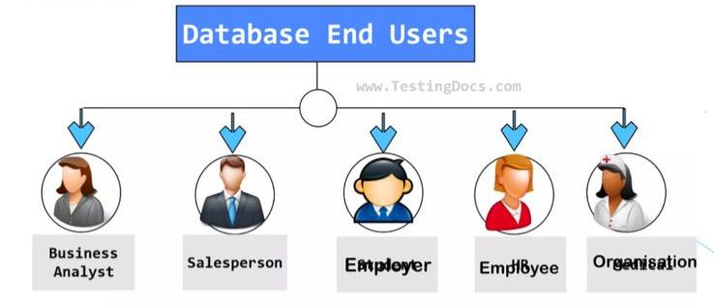
Who are the end users?

Slide 7

Our Solution and it’s value proposition
Conditional Formatting – Missing Filter – Remove Formulae – Performance Pivot – Summary Gragh – Data Visualization

Slide 8
Dataset Description
Employee dataset – Kaggle 26 Features Employee ID – DE5B5E0E981696191474813EBC226A7F Name – Text Performance Level – Very High , High , Medium , Low Gender – Male , Female Employee Ratings

Slide 9

The “wow” in our Solution
Performance level IFS(Z8-5,”VERY HIGH” 28 -4,”HIGH”,28>-3,”MED”, TRUE, “LOW”)

Slide 10

Modelling
Data collection : 1). Department 2). Division 3). Job Function 4). Employee Classification DATA CLEANING: 1). Start date 2). End date PERFORMANCE LEVEL: 1). Very high 2). High 3). Medium 4). Low

Slide 11
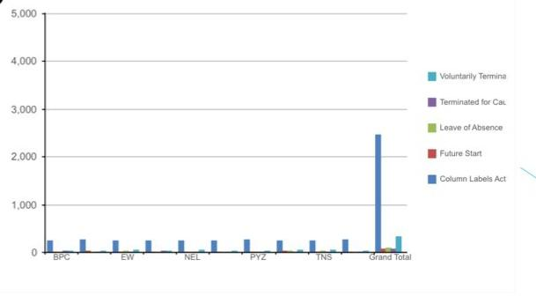
Results

Slide 12
Conclusion
In conclusion, a thorough summary for a data analysis in a research study involves strategically synthesizing the key findings regarding each employee’s performance level, highlighting their implications, and briefly outlining their contributions to the organization.

